Slide 1
Cal Poly Pomona
Purple Air Data
Andrew Sison

Slide 2
Purple Air
Purple Air is a company that creates air quality sensors, and these sensors can collect and contain data on airborne particulate matter (PM), temperature, and humidity %.
PM describes solid particles that are suspended in air including dust, smoke, and other organic and inorganic particles. PM 2.5 for instance, includes fine inhalable particles, with an aerodynamic diameter 2.5 micrometers and smaller.
The data contained within the Purple Air Sensors can be found at www.purpleair.com/sensorlist

Slide 3
Particulate Matter (PM)
High levels of PM can be hazardous, and can be especially harmful to specific groups of people, such as children and elderly.
According to the US Environmental Protection Agency (EPA), healthy air quality standards for 24-hour, and annual PM2.5 would be 35, and 12 micrograms per cubic meter (μg/m3) respectively. PM2.5 poses the greatest risk to health.
For 24-hour, and annual PM10.0 it would be 150, and 50 μg/m3.Though as of 2006, the annual standard for PM 10.0 has been revoked because of lack of evidence between long term exposure, and health problems.

Slide 4
Effects of Particulate Matter
Particles in the PM2.5 size range can travel deep into the respiratory tract, and reach the lungs, causing irritation, coughing, and shortness of breath.
Exposure to PM can also cause short-term health effects such as eye, nose, and throat irritation, sneezing, and runny nose.
Studies have shown that long term exposure to PM may be associated with increased rates of chronic bronchitis, reduced lung function and increased mortality from lung cancer and heart disease.
Notes:
https://www.health.ny.gov/environmental/indoors/air/pmq_a.htm

Slide 5
Dataset
The dataset used for this project is from a sensor located in Cal Poly Pomona, labeled “CCA_CalPolyPomona”. The dataset is in the form of a csv file and contains data from February 6th 2019 to September 27th 2019, and is approximately 15.7 MB in size.
The data within includes, PM1.0, PM2.5, PM10.0, temperature, and humidity %, and is collected every 1-2 minutes.
The Santa Rosa and Los Angeles datasets used for the comparisons are of the same time period and are 15.2 MB and 14.6 MB respectively.

Slide 6
Platform Used
Language: Python
Pandas, NumPy, Matplotlib, datetime
Editor: Visual Studio Code

Slide 7
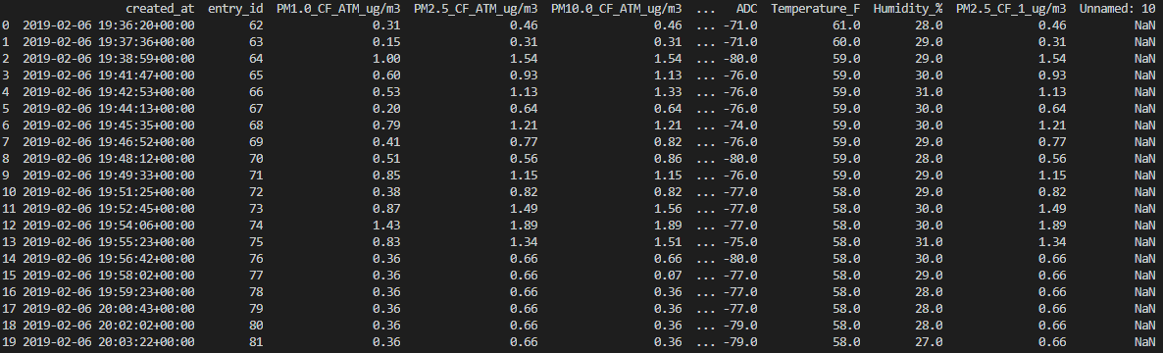
Dataset: first 20 lines

Slide 8
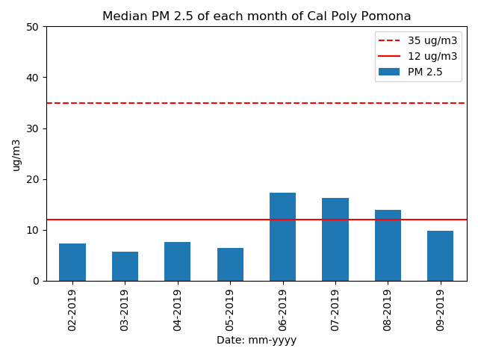
How are CPP’s PM 2.5 levels per Month?
We are within the healthy PM 2.5 24-hour range by a large margin.
In June, July, and August, the air quality is bad, and PM 2.5 levels are over the annual healthy limit.
From February to May, PM 2.5 levels are low and air quality is great.
PM 2.5 levels goes from very low to very high from May to June.

Slide 9
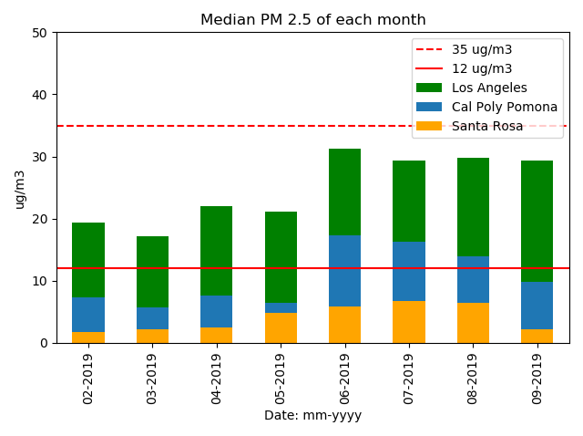
How does CPP’s PM 2.5 levels compare to others?
LA has some of the worst air pollution, and Santa Rosa has some of the best air quality.
We can see that CPP is in between the two, but closer to Santa Rosa, the cleaner city.
LA, Santa Rosa, and CPP all get the highest PM2.5 levels from June, July, and August.

Slide 10
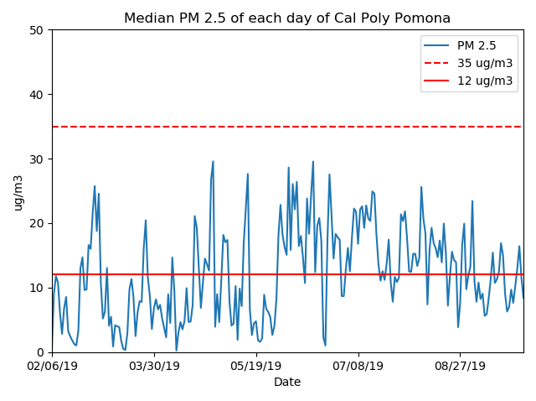
How are CPP’s PM 2.5 levels per day?
There doesn’t exist a day, where PM 2.5 levels are above 35 ug/m^3
There are multiple days where PM 2.5 levels are above the healthy annual standard of 12 ug/m^3.
Most people will be fine to long term exposure to the air in Cal Poly Pomona.

Slide 11
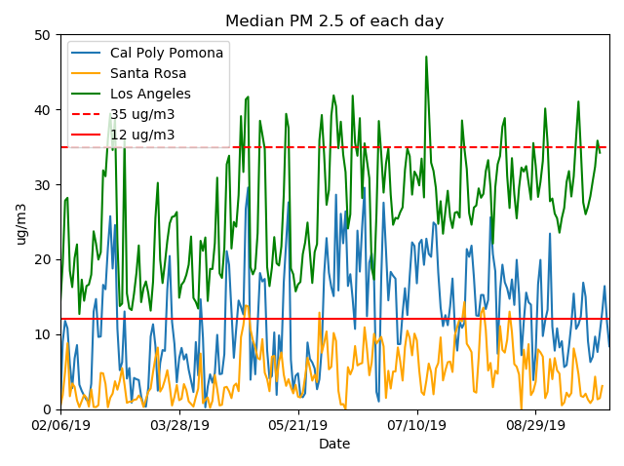
How does it compare to other cities?
LA has multiple days where PM 2.5 levels are above the annual standard and all days are above the 24-hour standard.
Santa Rosa has only a few days above the the annual standard and none above the 24-hour standard.
Long-term exposure to LA air will be bad for most people, especially compared to CPP, and Santa Rosa.

Slide 12
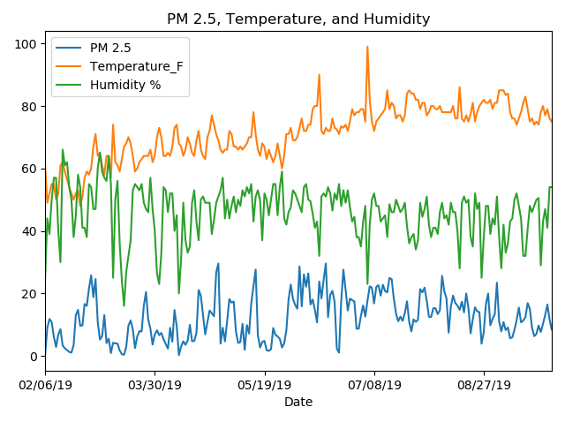
Is there a relationship between PM 2.5, Temperature, Humidity % and Time?
PM and humidity seem to increase and decrease together.
Humidity and PM seem to have an opposing relationship with temperature. Temperature seems to increase when the others decreases.

Slide 13
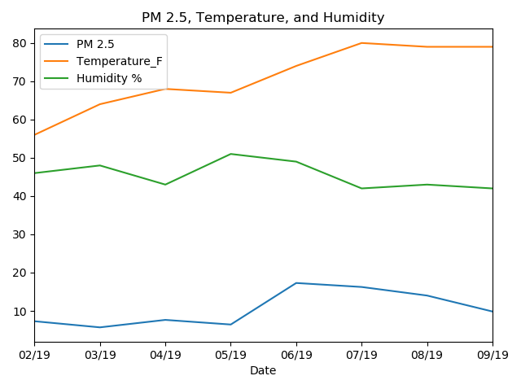
PM 2.5, Temp, and Humidity (Cont.)
It’s possible that PM levels increase as temperature increases because more people use air-conditioning during the hotter months.

Slide 14
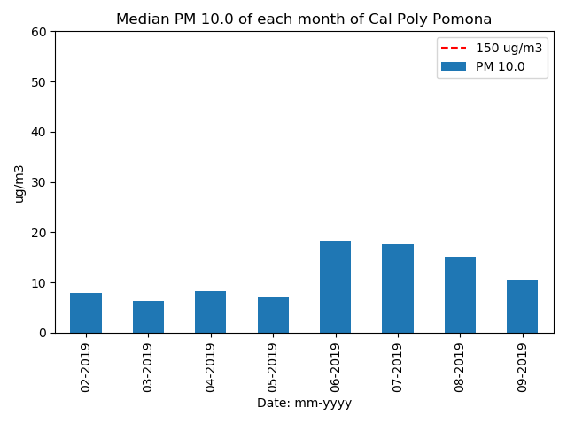
How are CPP’s PM 10 levels per Month?
They’re healthy, as they’re all way below 150 ug/m^3.
Just like PM 2.5, there is a huge increase in June from May.

Slide 15
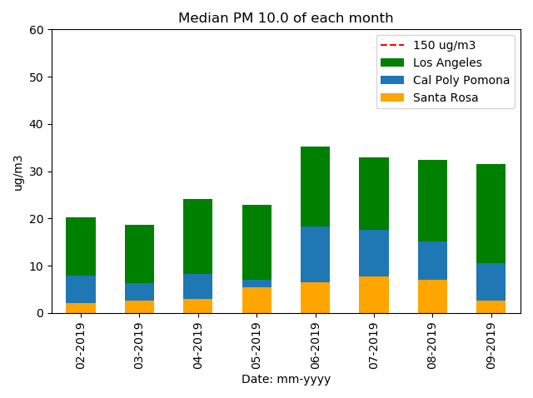
How does CPP’s PM 10 levels compare to others?
No city has any month above the 24-hour standard.
The latter four months still in general have the highest levels of PM levels.

Slide 16
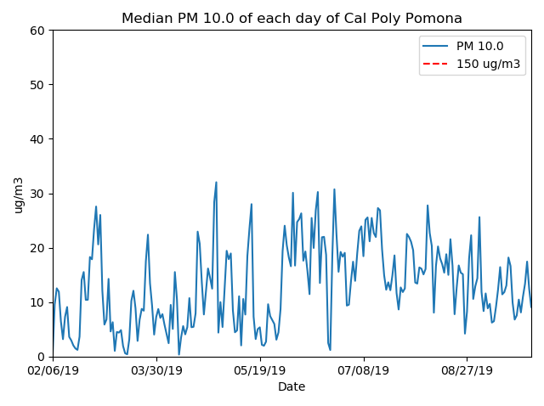
Are there any days over the 24-hour standard?
There are no days above the 24-hour standard.
All of CPP’s PM 10 levels are way below the 24-hour standard of 150 ug/m^3, so nothing to worry about in this regard.

Slide 17
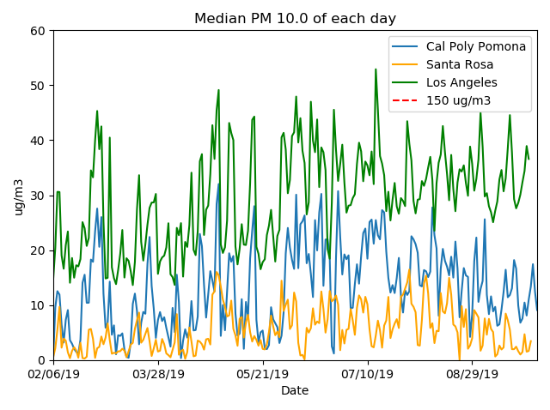
How does it compare to other cities?
For both LA, and Santa Rosa, the PM 10 levels are below the 24-hour standard.
PM 10 levels don’t seem to be any issue for any day in any city.

Slide 18
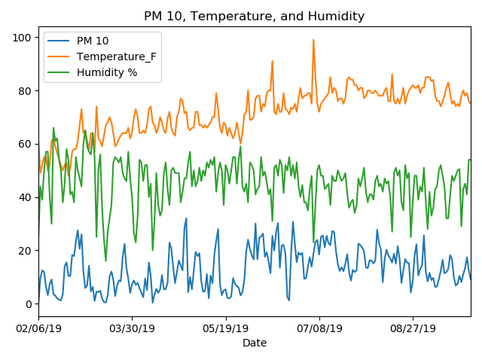
Is there a relationship between PM 10, Temperature, Humidity % and Time?
Similar to PM 2.5.
As temperature rises, so too does PM 10.
Humidity decreases, and PM and temperature rises.

Slide 19
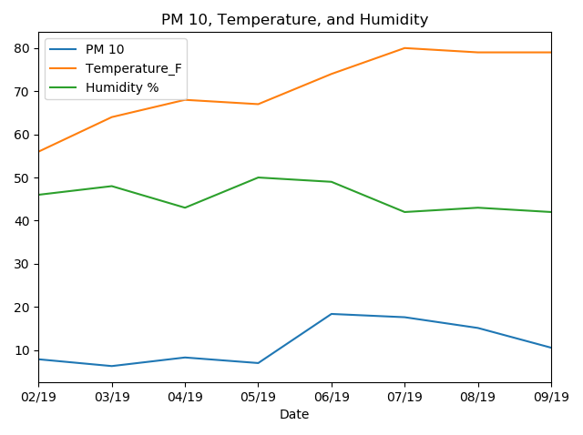
PM 10, Temp, and Humidity (Cont.)
Same as before but aggregated by months.

Slide 20
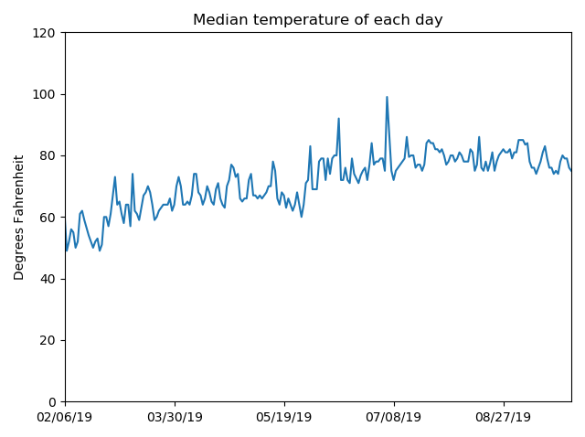
How’s the temperature by day in Cal Poly Pomona?
No extremes except for one day in late June

Slide 21
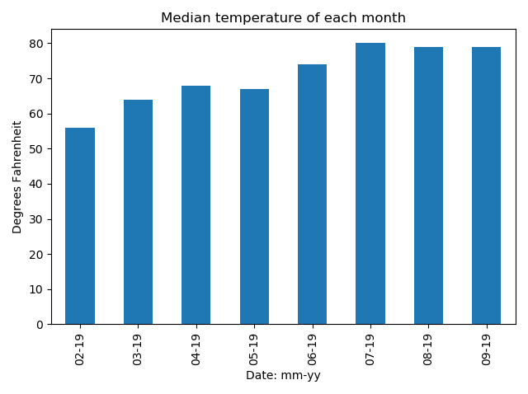
How is the temperature each month in CPP?
No extremes in temperature on average.
Hottest month was July
Coldest month was February, but neither December or January was included because the sensor was off during January.

Slide 22
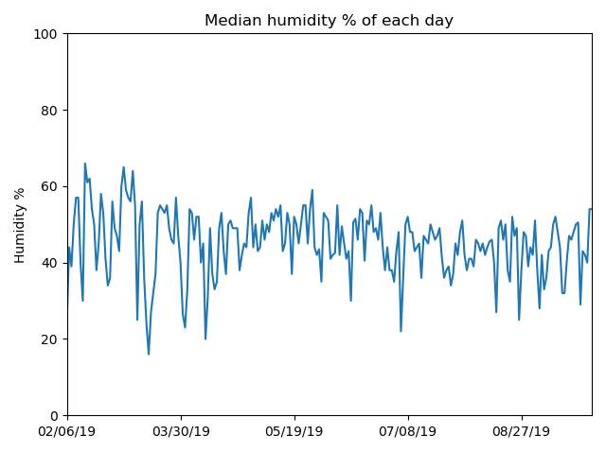
What is the humidity like each day?
There are huge changes in humidity % during the months of February, and March. This is because of the high levels of precipitation and chance of rain.
The rest of the months don’t have any huge changes in humidity.

Slide 23
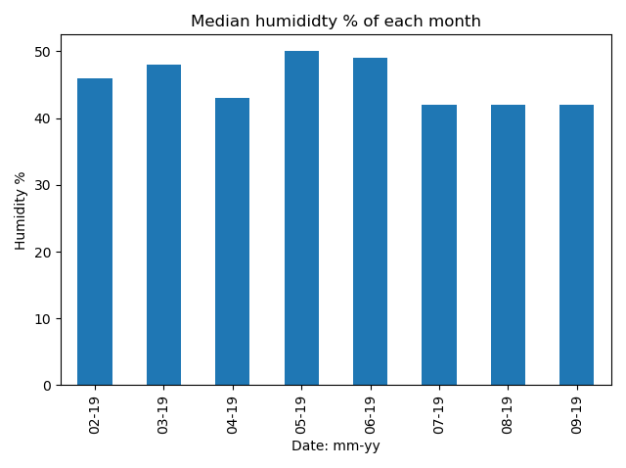
Average Humidity Each Month?
July, August, and September all have the same median.
May has the highest humidity percentage among the 8.

